Slide 1
Distributed RT Systems
Introduction
ITV Multiprogramming and Real-Time Systems
Anders P. Ravn
Aalborg University
April 2009

Slide 2
Prerequisites
Understanding of Real-Time Systems for monoprocessor systems
Understanding of Distributed Systems

Slide 3
Aims
Understanding the issues in combining RT and Distributed Architectures
Ability to model and analyse such systems
To stimulate research interest

Slide 4
What is a real-time system?
A real-time system is a computerized system that must respond to externally generated input within specified time bounds
The computer is a component in a larger engineering system -
EMBEDDED COMPUTER SYSTEM

Slide 5
A simple fluid control system
Interface
Pipe
Input flow
reading
Flow meter
Processing
Valve
Output valve
angle
Computer

Slide 6
A distributed fluid control system
Interface
Pipe
Input flow
reading
Flow meter
Processing
Output valve
angle
Valve
Computers and Network

Slide 7
The Periodic Control Task
Tightly Coupled : OR Distributed:
LOOP
wait_until(t)
read_sensor;
send reading;
t = t+T;
END
LOOP
wait_until(t)
read_sensor;
compute;
write_actuator;
t = t+T;
END
LOOP
get reading;
compute;
send setting
END
LOOP
get setting
write_actuator;
END

Slide 8
The R-T Constraints
Have not changed !

Slide 9
Terminology
Hard real-time
Soft real-time
Firm real-time
Time
Value of response
D
Time
D
D may be missed occasionally

Slide 10
RTS Design
Essentially:
Specification of a collection of periodic and sporadic tasks.
Tasks may share resources, but must not block explicitly.
Formalisms:
UML-RT
RT- HOOD
NEW:
Selection and Analysis of network
OR
Selection of a Distributed R-T platform

Slide 11
Validation
Verification
Testing
Simulation
Model
Prototype with Test harness
Real System
ON

Slide 12
Characteristics of a RTS
Timing Constraints
Dependability Requirements
Concurrent control of separate components
Facilities to interact with special purpose hardware
Have not changed !

Slide 13
Analysis Tools
Response Time Analysis for Networks and processors (BW 14.7)
Model checking of Networks of Timed Automata (UppAal)
Simulation Tools

Slide 14
Platforms
Time Triggered Architecture (BW p. 568)
CORBA-RT (BW 14.4.4)

Slide 15
Distributed Algorithms
Clock Synchronization (BW 14.6.2)
Fault Tolerance (BW 14.5)

Slide 16
Networks
CAN
TT-CAN
TTP/C Protocol
ARINC 629
WorldFIP
PROFIBUS
…

Slide 17
CAN
initial target automotive applications
a multi-master architecture
a broadcast shared bus,
the transmission medium is usually a twisted pair cable
network maximum length depends on the data rate (e.g. 40m @ 1 Mbps; 1300m @ 50 Kbps)
The arbitration uses a CSMA non-destructive bit-wise protocol in which the controller transmitting the message with lowest identifier wins access to the medium and continues transmission.
The remaining controllers detect a collision back off and retry again
The traffic scheduling at the bus access level is thus based on fixed priorities. applications.
The addressing is indirect and based on the identifiers, too.
The CAN protocol does not specify an application layer.

Slide 18
TTP/C Protocol
a fault-tolerance oriented communication protocol
clock synchronization
membership service
fast error detection and consistency checks
. A network consists of a set of communicating nodes connected by a replicated network
. A node comprises a host computer and a TTP/C communication controller.
The medium access control is based on TDMA with bus time divided into slots, each statically assigned to one node. In each slot each node transmits one frame. The frame cycle is called a
Messages are piggybacked within the frames transmitted by each node.
The protocol defines 4 transmission speed classes ( 500Kbps, 1Mbps, 2Mbps and more recently 25Mbps)
an application layer that delivers configuration and messaging services.

Slide 19
Middleware
Masks system and network heterogeneity
Hides complexity of distributed systems

Slide 20
CORBA
Minimum CORBA
Asynchronous Method Invocation
Real-Time CORBA

Slide 21
Real Time CORBA
Policies and mechanisms for specifying end-to-end application QoS requirements.
QoS enforcement from real-time operating systems and networks.
Optimized real-time communication protocols
Optimized real-time request demultiplexing and dispatching.
Optimized memory management.
Optimized presentation layer

Slide 22
AMI
allows exchange of asynchronous requests
Static Invocation Interface (SII)
Polling model: each two-way operation returns a local object Poller. A client can use the Poller to check the status of a request.
Callback model: when a client invokes a two-way asynchronous operation on an object, it passes an reference for a reply handler servant as a parameter.

Slide 23
Message Oriented Middleware
Java Message Service (JMS)
Data Distribution Service for Real-Time systems (DDS)

Slide 24
The CAN bus

Slide 25
Physical Layer
Serial bus
Electrical properties and timing see:
  http://www.semiconductors.bosch.de/en/20/can/3-literature.asp
Dominant and Recessive encoding:
dominant is logical 0
recessive is logical 1
simultanous transmission gives logical AND

Slide 26
Frame Format
Field name | Length (bits) | Purpose
Start-of-frame | 1 | Dominant 0
Identifier | 11 | Sender id
RTR | 1 | Dominant 0
Identifier extension | 1 | Dominant 0
Reserved | 1
Data length (bytes) | 4 | 0-8
Data field | 0 - 64
CRC15 | 15
CRC delimiter | 1 | Recessive 1
ACK | 1
ACK delimiter | 1 | Recessive 1
End-of-frame | 7 | Recessive 1

Slide 27
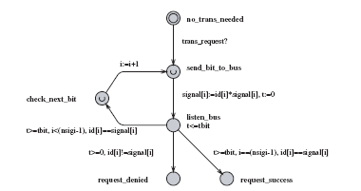
Medium Access Control
Hanz p. 6

Slide 28
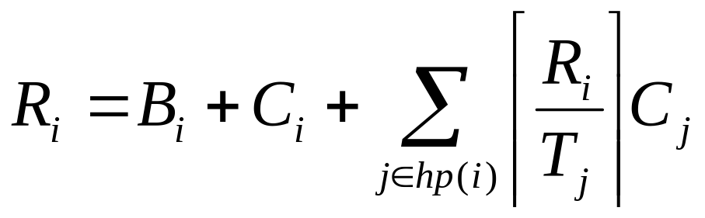
Simple Analysis
One process per processor
No error handling
Hanz p. 10, CAN bus paper

Slide 29
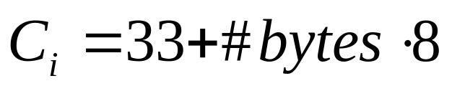
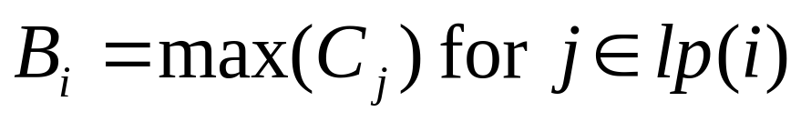
Simple Analysis
Hanz p. 10, CAN bus paper

Slide 30
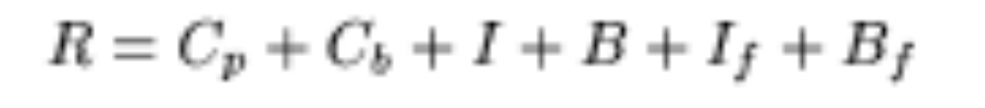
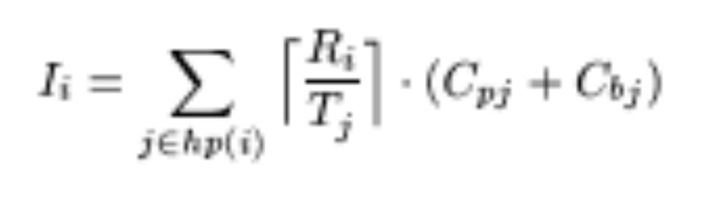
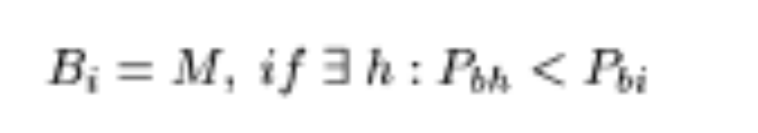
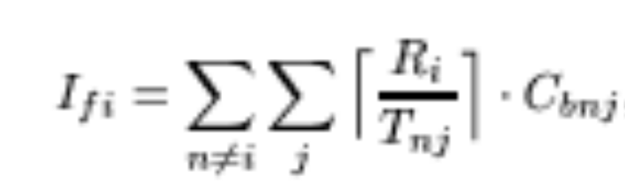
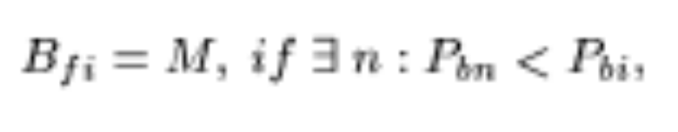
Extended Analysis
j in hp(i)

Slide 31
Remarks
There is no easy way of finding an optimal assignment for the extended case!
The formulas are too pessimistic M, Cross-interference
Experimental validation.

Slide 32
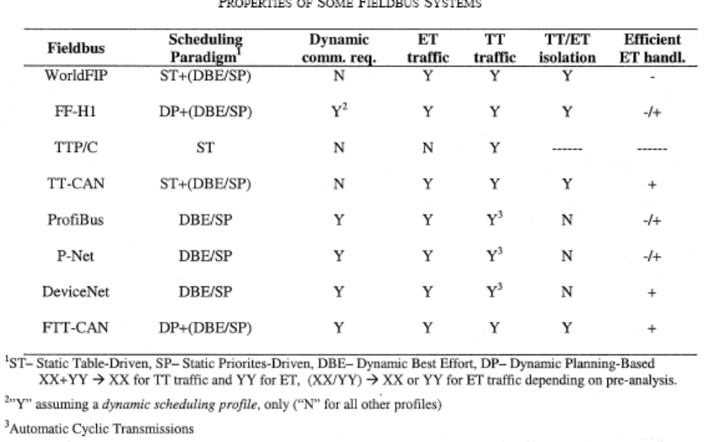
FTT-CAN
Static versus Dynamic Traffic Scheduling
Event versus Time Triggered Communication

Slide 33
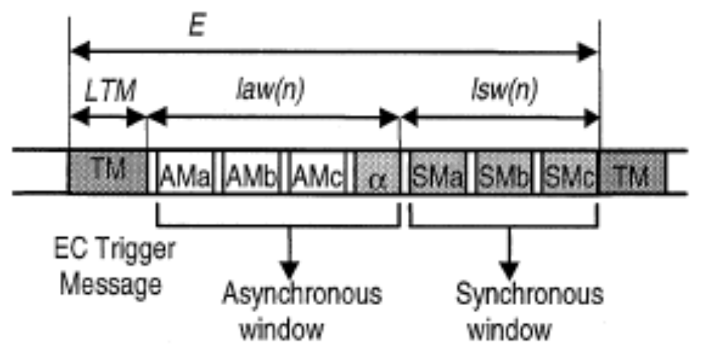
FFT-CAN E-cycle

Slide 34
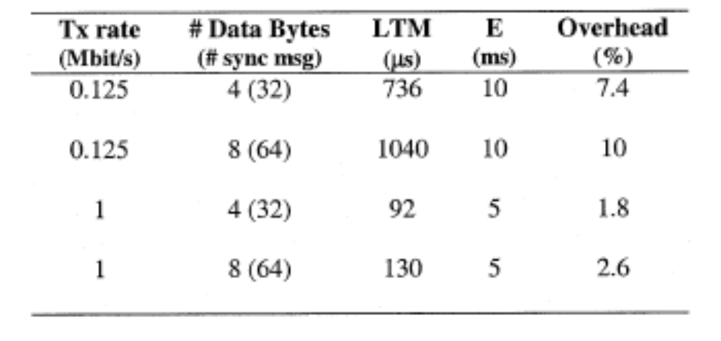
Overhead

Slide 35
Synchronous Messaging System
SRT entries:
DLC – data length
C - max transmission time
Ph - relative phase
P - Period measured in E’s (T)
D - Deadline
Pr - fixed priority

Slide 36
For Each E-cycle
A synchronous schedule is broadcast with the EC-Trigger Message
Plan based scheduling
On-line scheduling

Slide 37
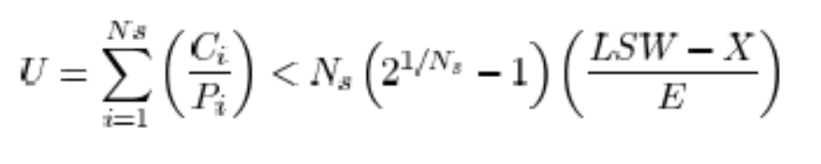
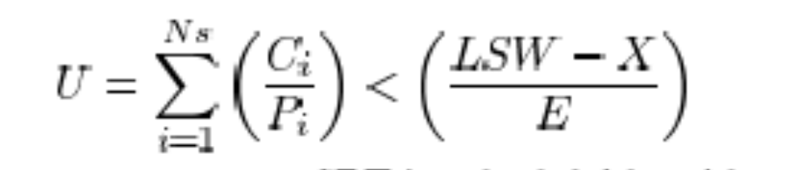

Schedulability Analysis
Blocking free non-preemptive scheduling
RM:
EDF:

Slide 38
Asynchronous Messaging System
ART entries:
DLC – data length
C - max transmission time
MIT - min interarrival time in E’s
D - Deadline
Pr - fixed priority

Slide 39
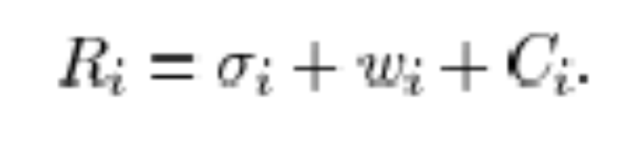
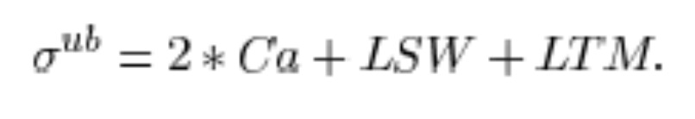

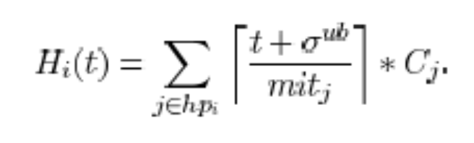
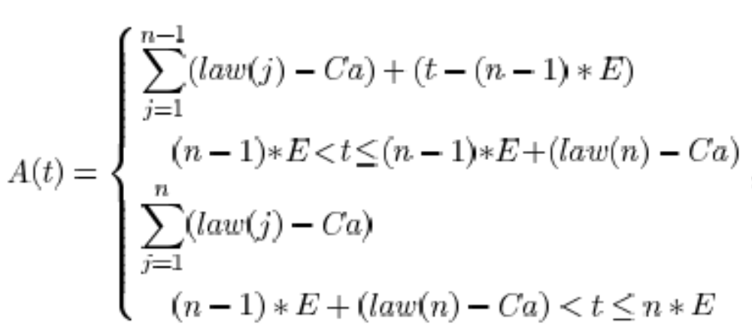
Schedulability Analysis

Slide 40
Remarks
Transmission errors not treated
Master selection not treated

